Slide 1

Finding your startup idea
www.antler.co
Notes:
Session can be 60-90 minutes. 90 minutes if engaging heavily with audience
On engaging the audience: There will be many in the audience who have first-hand experience. Get into questions like:
Who have started a company that failed? OK great, why did it fail?
Can get 2-3 examples early on. Those that are about the company rather than co-founder issues, save them for the relevant sections. Will probably map into
not the right problem
too broad focus early on - not finding the early adopters
not able to build a moat
not enough passion/love for the problem and gave up
And can pull these up during the session.

Slide 2
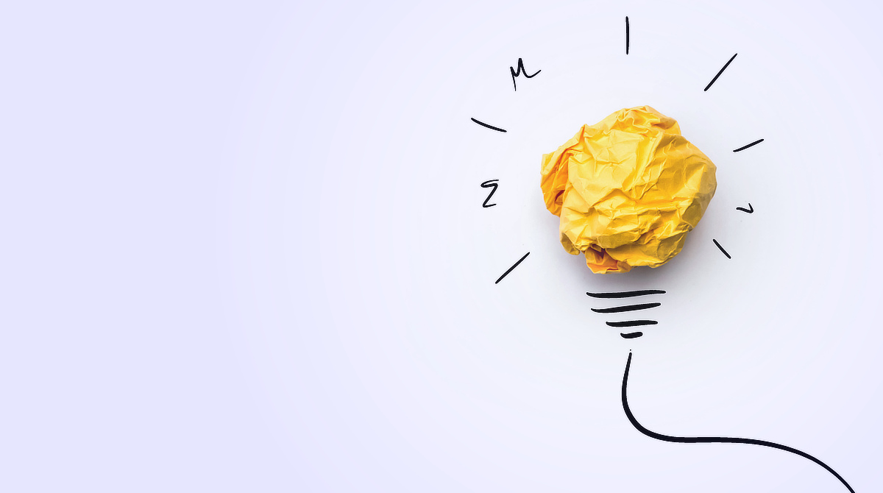
What is a startup?
Notes:
Ask the audience how they’d define a startup.
Likely, all answers will be right but they all culminate in: STARTUP = GROWTH

Slide 3
Startup = growth
A startup is a company designed to grow fast
Notes:
A startup is a company designed to grow fast.
Why?
For a VC to fund your company, they need to see an opportunity that can be big - think $10-100m revenues in 5-10 years
You’re starting at 0
Thus to get to that level of revenues you NEED to grow extremely fast. There’s no other way to get to the scale you need

Slide 4
It is also…
An experiment to prove a non-obvious hypothesis
Notes:
Why an experiment and why non-obvious?
Well, if it was obvious that it would work, it would likely already exist.
The startup phase is about verifying whether your hypothesis of how to solve a problem, how to acquire customers and how to monetize your solving the problem.

Slide 5
Three elements of a startup hypothesis
Problem
Solution
Why you?
Notes:
Proving the hypothesis includes proving that:
The problem is painful enough that you can build a successful company by solving it
Your solution solves the problem in a way that is so good that you can charge a lot for it and grow fast
You are the right team to win - you have a unique unfair advantage that will make you able to grow this company faster than anyone else

Slide 6
1. The problem

Slide 7
Fall in love with the problem, not the solution
Uri Levine
Waze co-founder
Notes:
Do NOT start with the solution.
Don’t say “I want to use this technology to solve a problem - what problem should I solve?”
Why? There are thousands of problems to solve, but only a small percentage of those have the nature that a successful startup can be built to solve it. Of those, each will require their very specific solution that is unique to that problem. By starting with the solution, it’s more likely that you’ll find a problem for which this solution to be perfect, rather than a problem that allows for building a great company.

Slide 8
Characteristics of a good problem to solve
Painful: so painful or expensive that users will pay a lot to solve it
Popular: millions of potential users
Frequent: users run into the problem several times per day
Urgent: needs to be solved right now (e.g. Covid-19)
Growing: growing 20%+ per year
Unavoidable: problems you cannot avoid solving, e.g. due to (new) regulation
Notes:
These are the characteristics of a good problem to solve.

Slide 9
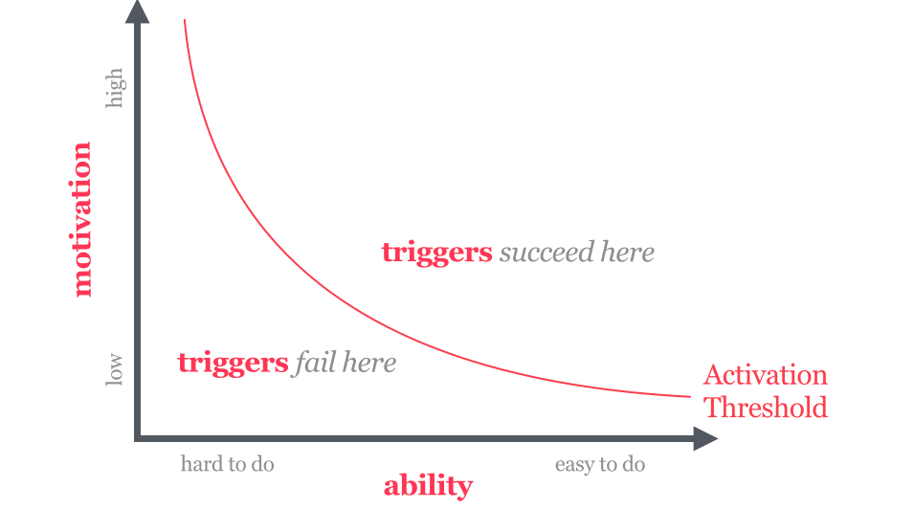
Combining the elements of a good problem to solve
B.J. Fogg model for behavioral change
Notes:
B.J. Fogg (Stanford researcher and renowned thinker on tech-enabled behavioral change).

Slide 10

How Facebook grew faster than any other company
With extremely high frequency of triggers
Notes:
How facebook became the most successful social network
High motivation - people wanted an online platform with their real identity (this was non-obvious)
High ability - signup easy, product is good, and it is completely free
Extreme frequency of triggers - if you were not a user, you’d get invited by any friend that joined. If you were a user you’d get a notification every time a friend did anything - triggering you to go to the site

Slide 11
2. The solution

Slide 12
Start with the assumption that the best way to do something is not the way it’s being done right now
Aaron Levie
Box founder

Slide 13
You have to start with the customer experience and work backwards to the technology
Steve Jobs
Apple co-founder

Slide 14
T
Imagine your startup to be like a T
Potential new customer segments, products, verticals
The initial niche where you will grow your product fastest
Notes:
Traction.

Slide 15
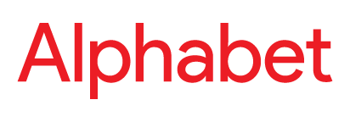
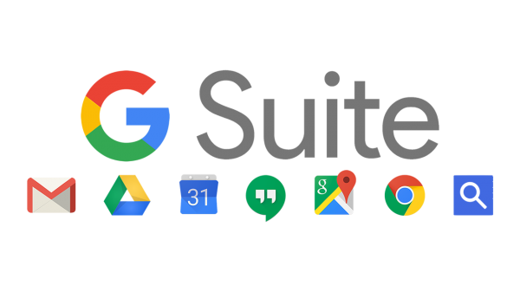

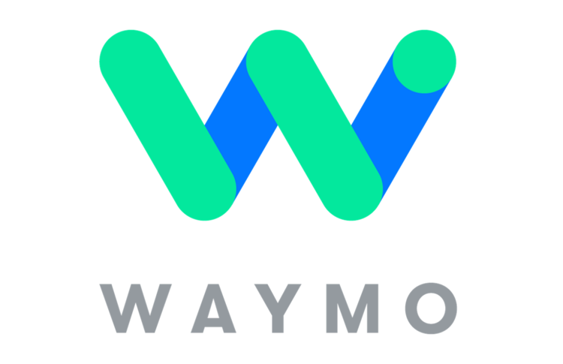



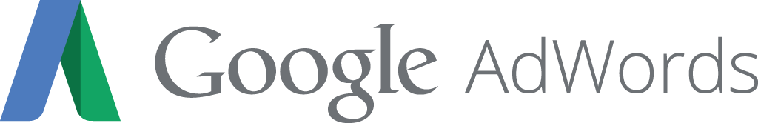


T
Example: Google → Alphabet
2015-
1998
2000-2015
T
I
Solving search for early internet adopters
Dominating search. Monetization: AdWords
Branching out to dominate large parts of consumer internet
Notes:
Traction.

Slide 16
3. Why you?

Slide 17
You need an unfair advantage
For every problem there will be 100s of teams working to solve it
Once someone identifies a great solution, others will copy it - and they may run faster than you
You need a strong “unfair advantage” that allows you to beat everyone else

Slide 18
What can be your unfair advantage
Founding team
Product
Acquisition
Moats
You don’t need to have all of these, but all great companies have all
Some you can build from the start, and some you develop over time

Slide 19
Unfair advantages
Founding team
Product
Acquisition
Moats
Only if you are really unique, e.g.:
You are 1 out of only a handful of people in the world that can solve the problem.
You have founded a successful company before, and can bring in investors and rockstar employees quickly.
Notes:
It’s very few founders where they themselves are the unfair advantage - especially for the long term.
If you are one of very few people in the entire world that can solve the problem, and any company would collapse if you leave, then you may have something.
Experienced founders may get quicker to capital and great employees but that’s not necessarily sustainable. Only a head start

Slide 20
Unfair advantages
Founding team
Product
Acquisition
Moats
Your product is 10x better than the next best thing on the most important metric, e.g. speed, price etc.
This is an important advantage that you need to build, but it will not last on its own, as products are easy to copy (patents help where relevant but mostly they won’t stop others).

Slide 21
Unfair advantages
Founding team
Product
Acquisition
Moats
You are able to grow more quickly and cheaply than others, ideally at $0 cost
Can be a starting advantage, e.g. you’ve got 50k Twitter followers that are your early adopters
But ideally you build a sustainable advantage, allowing you to grow fast, cheaply. The best companies grow through word of mouth or by users using its product.
Notes:
Word-of-mouth: often comes from having a great product. Related to the previous point on the product.
E.g. how Hotmail grew: every email sent from Hotmail had: “Sent from Hotmail. Want a free email account? Sign-up for Hotmail today!”
Facebook, as mentioned, grew extremely fast since every friend would invite you to Facebook and then remind you every hour that Facebook is there.

Slide 22
Unfair advantages
Founding team
Product
Acquisition
Moats
Less important for short-term traction but the most important for long-term success and world dominance.
You should have a view on how you can build a competitive moat that makes it really hard for your competitors to outcompete you.

Slide 23
Types of moats
Network effects
The value of the product for all users increases with each new user. E.g. social networks, marketplaces, operating systems.
Scale
High R&D cost but marginal cost of distribution is low/zero. E.g. SaaS, cloud services.
Brand
Can be long-lasting, but usually not apparent at the early stage.
Patents
Often not long-lasting - you can patent a solution (a drug), but not the problem (‘curing cancer’). Important for e.g. life science companies.
Switching costs
When your product integrates deeply in your customers’ tech or processes, e.g. fintech, tech infra.
Notes:
Network effects:
Network effects are exceptionally strong moats. Among the strongest.
Metcalfe’s law: V = a * n² - the value of a product is proportional to the square of the number of users
Scale:
Helpful, however this will come to every company that grows large. Scale moats are linear-ish where network effects are exponential. Scale can be achieved through capital whereas network effects only apply to certain products and catching up is harder and harder
Brand:
Very strong, however
Switching costs can be very strong
Get deeply ingrained in the users’ infrastructure. E.g. Stripe is the payment infrastructure for many apps such as Uber, and they’ve built the whole product around Stripe - very hard to tear out.
...

Slide 24
So - what is the right problem for you to solve?
As we’ve discussed:
A problem that is large, frequent, painful, growing, urgent and unavoidable
A problem where you have an unfair advantage
But also very important:
A problem you have first-hand experience with
A problem where you know the early adopters
A problem you are passionate about solving
A problem you will enjoy working on
Notes:
Discuss elements under “But also very important”: - It’s much more likely you’ll have an insight that is non-obvious, or design a great product if you’ve experienced the problem yourself
- Knowing the early adopters is about knowing really well for whom the problem applies. If you start out blind, you may be right but flame out in the search of the initial user base
- So many founders quit because they give up. It’s much easier to give up if you don’t have the passion or if you don’t enjoy the day-to-day of working on your product

Slide 25

Questions and comments

Slide 26
Moats have different value
Strong network effect (e.g. Facebook)
Value of moat
Scale (e.g. Uber)
Market share
Notes:
Network effects:
Network effects are exceptionally strong moats. Among the strongest.
Metcalfe’s law: V = a * n² - the value of a product is proportional to the square of the number of users
Scale:
Helpful, however this will come to every company that grows large. Scale moats are linear-ish where network effects are exponential. Scale can be achieved through capital whereas network effects only apply to certain products and catching up is harder and harder
Brand:
Very strong, however
Switching costs can be very strong
Get deeply ingrained in the users’ infrastructure. E.g. Stripe is the payment infrastructure for many apps such as Uber, and they’ve built the whole product around Stripe - very hard to tear out.
...

